Slide 1
IQRF

Slide 2
Simply Saving Energy for our customers for nearly 30 years
Family owned UK design and manufacture who, until recently concentrated on stand alone lighting controls sold mainly through the UK Wholesalers

Slide 3
Quality assurance
Designed and manufactured in the UK
5 year warranty

Slide 4
ECO Systems
Approx. 3 years ago DANLERS changed it’s focus and our aim is to become known as the go to company for ecosystem sensors
We have an agnostic approach to ecosystems
Our objective is to help the market move forward by embracing and supporting new technologies
IQRF is one we would very much like to support with our ever expanding product range

Slide 5
Product Range
Passive Infra-Red Occupancy switches (PIR)
Time Lag Switches
Agnostic approach for ecosystem ready sensors and products

Slide 6
Our current sensor range
ALL of our PIR sensors come with built in Light cell for (Lux) measuring
Identification led green/red
100-240Vac, 50/60Hz powered
Low voltage power options possible

Slide 7
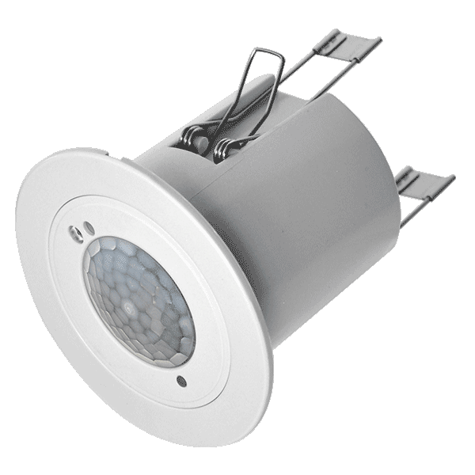
PIR (Passive infra Red) Sensors
Flush fitting

Slide 8
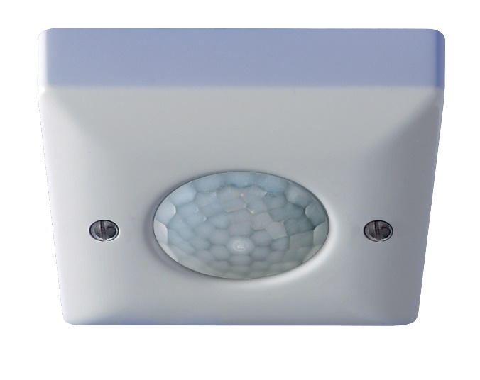
Surface Mounted

Slide 9
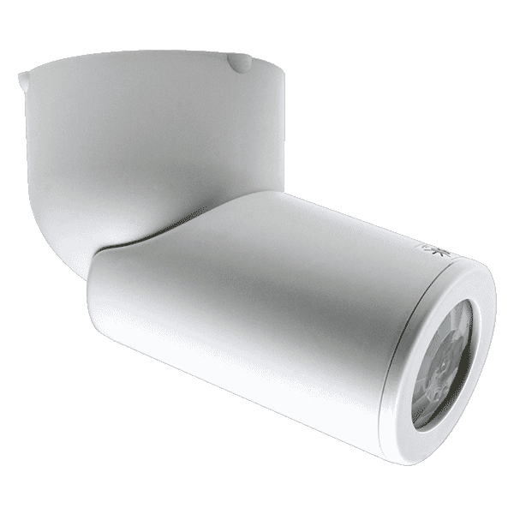
Directional options

Slide 10
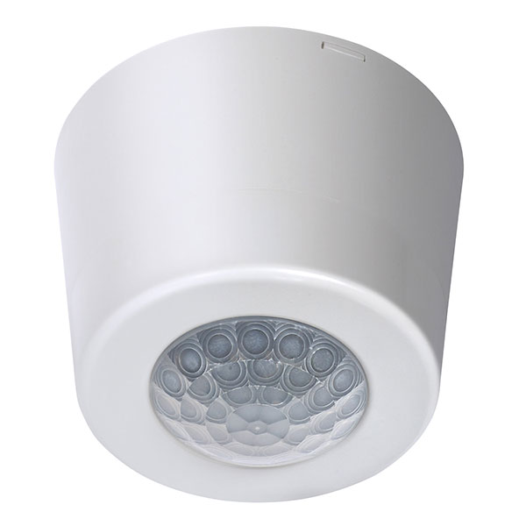
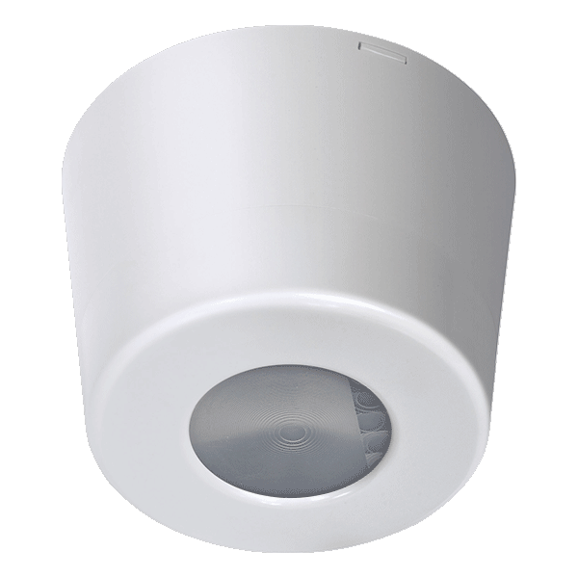
High bay mounting options
Wide detection
Aisle detection
Spot detection

Slide 11
Grid or OEM modules
Various detection options available from slight movement to 17M mounting height

Slide 12
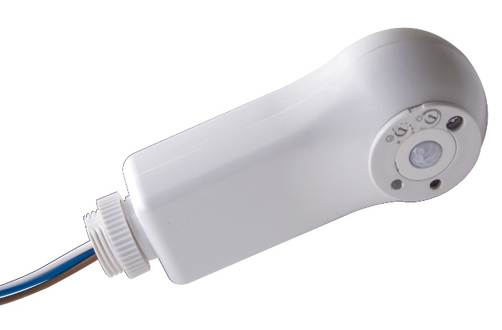
Batten Mount under development

Slide 13
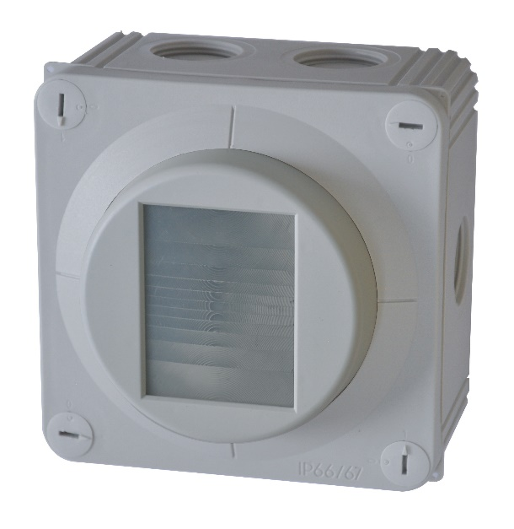
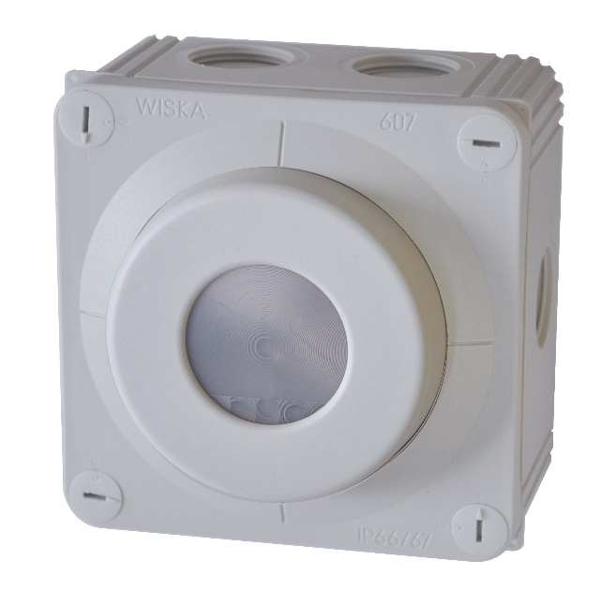
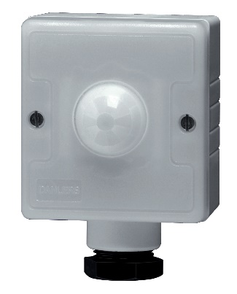
IP66 Rated

Slide 14
The Products

